Slide 1
Crafting ColdFusion Applications Like An Architect
Adobe ColdFusion Summit 2016
Software Architect VS Building Architect

Slide 2

Who am I
Shirak Avakian
Sr. Software Solution Architect
QBI LLC
shirakavakian@gmail.com
@shirakavakian
No Facebook

Slide 3
Subjects to cover
Software architect definition
Software architecture start point
Software architect vs building architect
Software architect vs code
My top 10 recommendations for successful ColdFusion application.

Slide 4
Software Architect
Software architecture refers to the high level structures of a software system, the discipline
of creating such structures, and the documentation of these structures.
Facts
Software architecture is about making fundamental structural choices which are costly to change once implemented.
Software architecture is all about structures not technology
Software architecture must have long term vision
Business requirement is a key factor to start software architect
Communication in software architect play big role on final outcome
Software architect should represent your system without compromises.

Slide 5
Software architecture start point

Slide 6
Software architecture start point
1- Step 1
Get the business requirements
Meet with Network administrator
Meet with dba
Sit down with actual employee (not a manager) and try write down all manual processes
2- Step 2
Putting things together
Choosing database
Choosing Technology
Cloud vs in-house

Slide 7
Software architect vs building architect

Slide 8
Software architect vs building architect
Building Architecture: Is both the process and the product of planning, designing, and constructing buildings and other physical structures.
Software Architecture: Is both the process and the product of planning, designing, and coding softwares and other physical requirements.

Slide 9
Let us compare side by side

Slide 10
Software architect vs building architect
Steps | Building | Software
1 | Meet the owner go over his/her vision | Meet with the department to go over their business requirements
2 | Lot size, city code, structure, square footage | Domain, application type, load, budget
3 | Provide blue print | High level diagram of application process

Slide 11
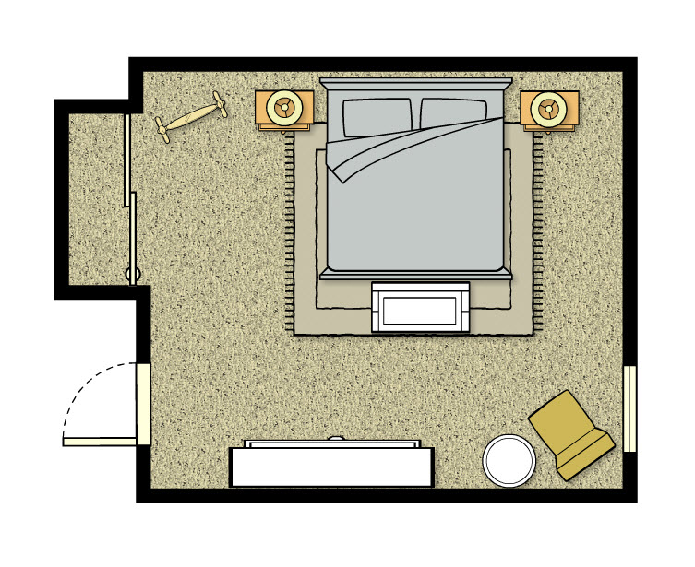
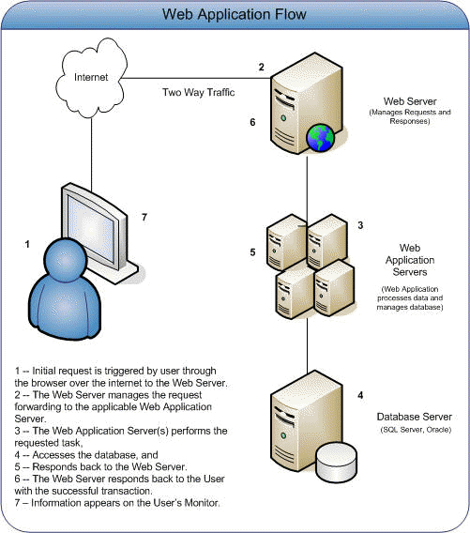
Software architect vs building architect
Building room floor plan
Application diagram

Slide 12
Let us Convert the room
to ColdFusion Code

Slide 13
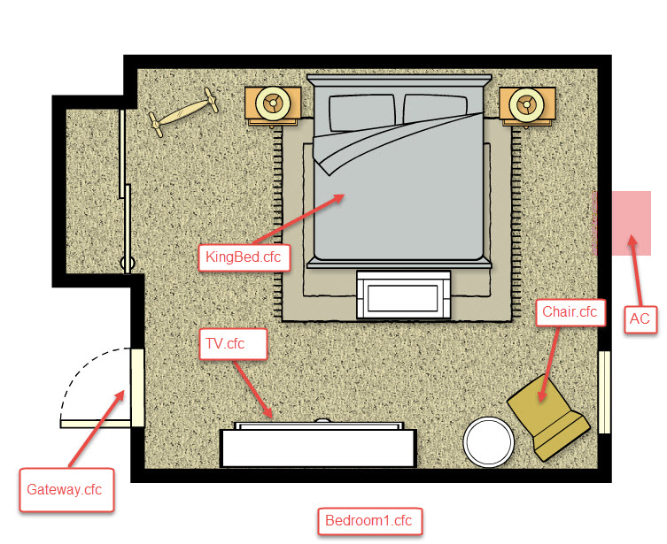
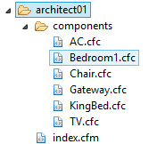
Software architect vs building architect
See Architect 01 source code

Slide 14
Software architect vs building architect
How do I know which method belong to which component?
Ask the component! If it make sense then it belongs to it
Example: HasChair() method makes total sense when you ask the Bedroom1.cfc
Can you ask Bedroom1 HasCar()? NO
See Architect 01 source code

Slide 15
Software architect vs building architect
Structure
Bedrom1
AC
Furniture
KingBed
Operations
getACType
TV
getChairColor()
Chair
hasChair()
hasTV()
hasBed()
hasFurniture()
Service Factory
Building
Packages
Business functions/objects
Services
See Architect 02 source code

Slide 16
Software architect vs code

Slide 17
Software architect vs code
1- Is OOP Software Architect?
2- Is MVC Application Framework Software Architect?
3- Is Multi tier application Software Architect?
No
No
No
Software Architect is all above and more
1- Objects
2- Services
3- Components (packages)

Slide 18
DEMO
CFSummit Application Architect

Slide 19
DEMO- Software architect vs code
UI to db vs db to UI

Slide 20
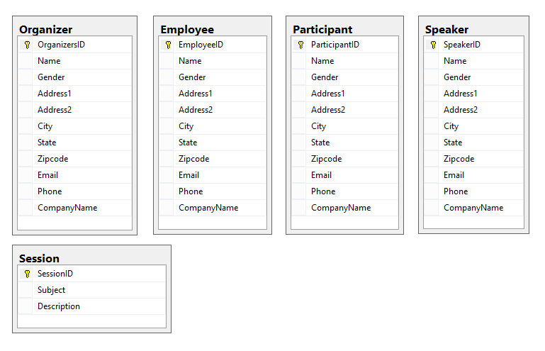
DEMO- Software architect vs code
Database
Database normalization,
or simply normalization, is the
process of organizing the columns
(attributes) and tables (relations) of
a relational database to minimize
data redundancy.(Wikipedia)

Slide 21
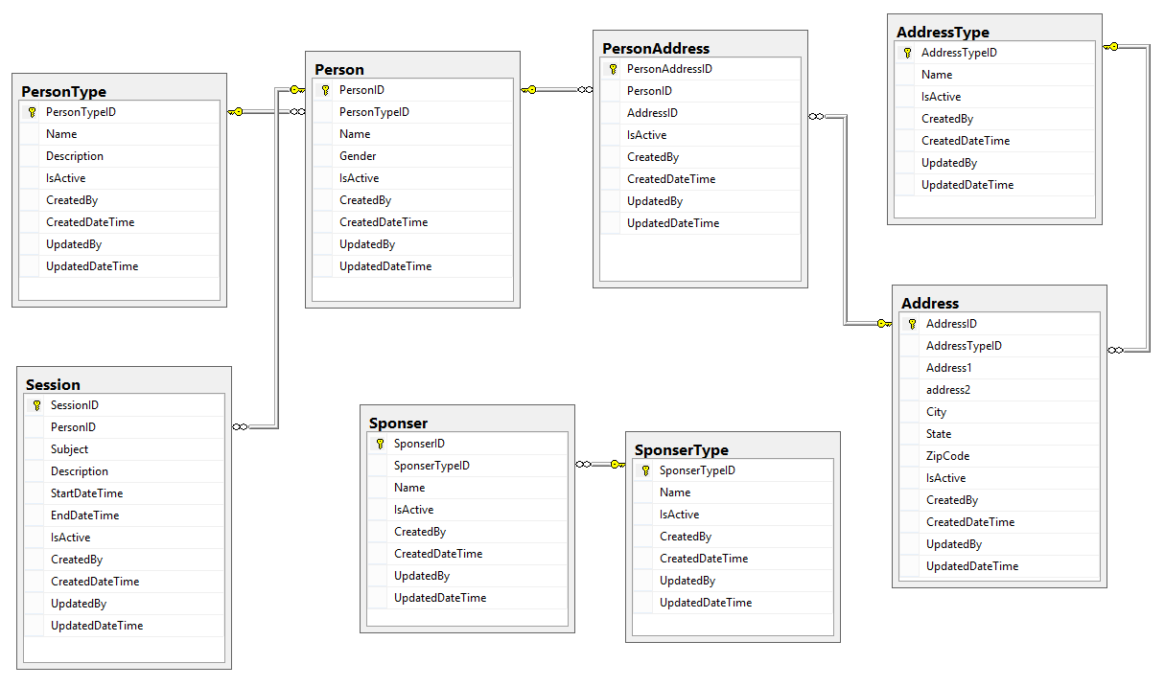
Software architect vs code
Database Best Practices
1- Normalize your database
2- Create separate SQL authentication
3- Create schemas
4- Use Store procedures & views
5- Prefix store procedures with usp
6- Don’t use plural form for tables names
7- Always create diagrams
8- Use constrains & foreign key’s
9- Use SQL Identity Increment
10- Define your primary keys
11- Always have common fields (columns)

Slide 22
Software architect vs code
Objects / Business Entities

Slide 23
Software architect vs code
View
Controller
Model
+ Services (API)
See Architect 02 source code

Slide 24
Software architect vs code
1- Normalize database
2- Create your repository components (Data access, ORM)
3- Test Case
4- Define your business entities
5- Create translator
6- Create Services
7- Test Case
8- Define your packages
9- Define your Gateways
10- Test Case
11- Create API, REST
12- Test Case
13- Create your MVC Model
14- Translator for View Model
15- Test Case
16- Controller
17- View
See Architect 02 source code

Slide 25
Software architect vs code
Multi tier application
Database
Repository Component OR Data Access layer
Services
Translator
Model
Translator
Controller
View

